Slide 1
ENERGY DETECTION FOR RANDOM ARRIVALS OF PRIMARY USERS USING GLRT ALGORITHM
V.S.AKHIL (14BEC0327)

Slide 2
ABSTRACT
Due to random arrivals of primary-user signals, the timing misalignment issue should be considered for spectrum sensing in cognitive radio (CR) systems, such as CR-based femto cell networks. To deal with this issue, two approaches were recommended in the literature, including Bayesian and generalized likelihood ratio test (GLRT) detectors. However, the Bayesian test requires perfect knowledge of the distribution of unknown parameters. Therefore, it is impractical due to its implementation complexity. To design a low-complexity energy detector (ED), this work proposes an ED scheme based on the GLRT algorithm. As a result, maximum-likelihood estimation for the timing misalignment is devised, and the performance of the proposed scheme is analyzed. The results show that the proposed GLRT detector features a low-complexity and satisfactory performance.

Slide 3
INTRODUCTION
Cognitive radio technology helps to use the RF spectrum more efficiently, by introducing secondary usage of the spectrum licensed to primary users (PU) but with a lower priority. A cognitive radio is able to change its transmitter parameters based on interaction with the environment. Secondary users (SU’s) equipped with cognitive radios can sense the spectrum and dynamically use spectrum holes in PU frequency bands for data transmission. Secondary users are not allowed to introduce any interference to the primary license holders.

Slide 4
INTRODUCTION (continued)
Therefore, before starting their transmission, they need to be aware of the presence of the PUs. Spectrum sensing is one method for detecting the presence or absence of a primary license holder. This is a challenging task because the PU signal is usually very weak due to fading, shadowing, etc. There are a few main categories of spectrum sensing including matched filtering, energy detection, cyclo-stationari tv-based detection and eigen value-based detection. Energy detection is the simplest method but it is optimized for impairment with additive white Gaussian noise (AWGN).

Slide 5
OBJCETIVES
The optimal estimation of the arrival time for a CR energy detection is devised. The estimation performance of the arrival time is analyzed. The GLRT detector is formulated and its performance is analyzed. The performance of the proposed GLRT detector offers a performance close to the benchmark, and it features a low computational complexity.

Slide 6
EXISTING SYSTEM
Using cognitive radios (CRs), the secondary users (SUs) are allowed to use the spectrum originally allocated to primary users (PUs) as long as the primary users are not using it temporarily. To avoid interference to the primary users, the SUs have to perform spectrum sensing before their attempts to transmit over the spectrum. Upon detecting that the PU is idle, the SUs can make use of the spectrum for transmission, and the overall utilization efficiency of the spectrum is enhance
DISADVANTAGES
Spectrum utilization is not efficient.
Noise is high.

Slide 7
PROPOSED SYSTEM as per the base paper
Generalized likelihood ratio test (GLRT) detector to tackle the issue on random arrivals of primary users that follow a Poisson process, while that in proposed a Bayesian detector for uniform arrival times. However, the distribution of timing misalignments is essentially unknown in a real system. The detection of idle spectra is typically considered as a binary hypothesis test in a low signal to noise ratio (SNR) region
PROPOSED SYSTEM ADVANTAGES
Spectrum utilization is high.
Noise is low compare to the existing system.

Slide 8
LITERATURE SURVEY
Title | Author | Date of Publication
Enabling Mobile Traffic Offloading via Energy Spectrum Trading | Tao Han, Student Member, IEEE, and Nirwan Ansari, Fellow, IEEE | JUNE 2014
Improved energy detection spectrum sensing for cognitive radio | : M. Lo´ pez-Benı´tez F. Casadevall Department of Signal Theory and Communications, Universitat Polite` cnica de Catalunya, Barcelona, Spain | : July 2010
Improving Spectrum Sensing Performance by Exploiting Multiuser Diversity | T. Do and B. L. Mark, | Mar. 2012.
On Green Energy Powered Cognitive Radio Networks. | X. Huang, T. Han, and N. Ansari. | 2015

Slide 9
Contents
System model
ML estimation of arrival time and its performance
Proposed GLRT detector
Performance evaluation and discussions
Introduction of local optimum detector
Estimation Performance
Detection Performance

Slide 10
SYSTEM MODEL
To handle the spectrum sensing issues in an asynchronous scenario, two approaches are typically adopted, including Bayesian and GLRT detectors. However, Bayesian test requires the perfect knowledge of the distribution of unknown parameters. Therefore, it is considered to be impractical and it has a relatively high complexity. To design a practical ED scheme based on GLRT principle , the timing misalignment is modeled by maximum-likelihood (ML) estimation

Slide 11
Contributions to the literature
The four major contributions made in this work can be summarized as follows
. 1) The optimal estimation of the arrival time for CR energy detection is devised.
2) The estimation performance of the arrival time is analyzed.
3) The GLRT detector is formulated and its performance is analyzed.
4) The performance of the proposed GLRT detector offers a performance close to the benchmark, and it features a low computational complexity

Slide 12
ML ESTIMATION OF ARRIVAL TIME AND ITS PERFORMANCE
Based on the signal model, under H1 hypothesis, the likelihood function ⇤(n0) can be expressed as

Slide 13



Where denotes the intersection operator, and the events E1 and E2 are defined as

Slide 14


By considering these we can calculate the probability of these events

Slide 15



Likewise, the probability for n0^ to be located on the right-hand side of n0 with an offset j, j>0, is written as
Where denotes the intersection operator, and the probability of events E3 and E4 are defined as

Slide 16

We can formulate the probability of other two events

Slide 17
PROPOSED GLRT DETECTOR
Based on ML estimation, when ˆn0 = n0, all useful signals of length N −n0 can be used for detection, and the proposed detector offers the same performance as the benchmark. When ˆn0 6= n0, there are two distinct cases defined as follows. 1) ˆn0 = n0 − j, where j > 0. In addition to N − n0 useful samples, j unwanted noise samples will also be utilized for detection. 2) ˆn0 = n0+j, where j > 0. The number of useful samples reduces to N −n0 −j.

Slide 18

Finally, Pd can be expressed as

Slide 19
PERFORMANCE EVALUATION AND DISCUSSIONS
Monte Carlo simulations were conducted to assess the performance of the proposed detector. The total number of observations is N = 160.
Estimation Performance
The performance P(ˆn0 & n0) of the proposed ML estimation with arrival time n0 = N/2 = 80, plotted as a function of sampling point ˆn0 for ⇠ = 0 dB and −5 dB, is presented. 3. As shown in the figure, P(ˆn0|n0) has the maximum value at n0. In addition, analytical results match to the simulation results very well. The estimation performance is critical for the proposed detector, because only when n0 = ˆn0, all useful samples can be employed for detection to achieve the optimal detection performance.

Slide 20
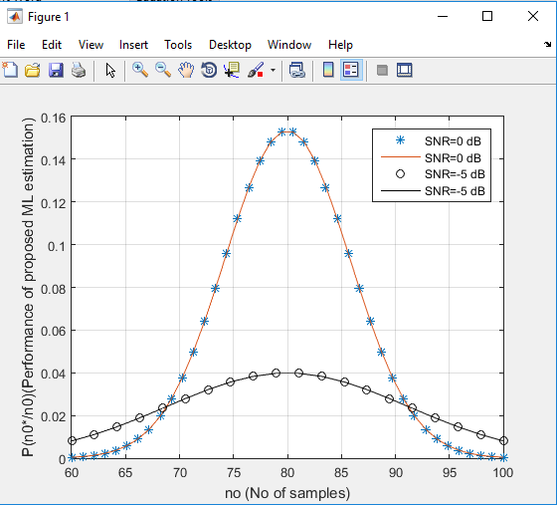
Estimation Performance
Output:

Slide 21
DETECTION PERFORMANCE
Plots the probability of detection Pd versus SNR for the proposed GLRT detector and conventional ED (under perfect synchronization) with Pfa = 0.1. The arrival time is assumed to be uniformly distributed over 0  n0  159. The conventional ED under perfect synchronization is used as a benchmark. As shown in the figure, the analytical results (Ana.) match to the simulation results (Sim.) very well. When SNR increases, Pd of the proposed detector improves consistently, and its performance can approach to that of the benchmark. The estimation is important for the proposed detector. As also shown in when there exists a fixed synchronization .

Slide 22
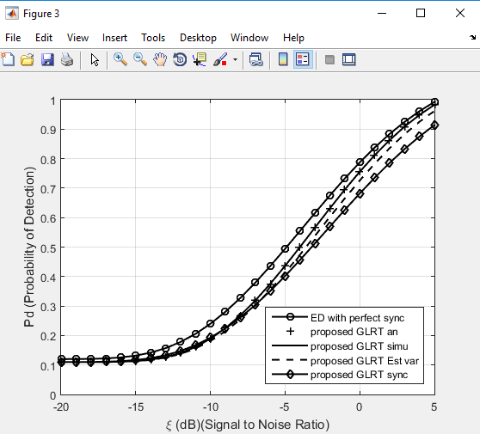
error of 30 samples, the performance of the GLRT detector (Sync. Err.) Degrades significantly.

Slide 23
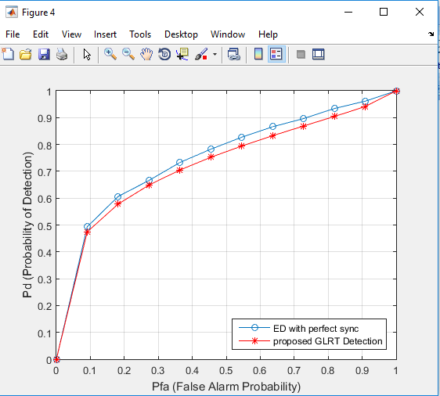
Detection Performance
The receiver operating characteristic (ROC), i.e., Pd, which was plotted as a function of Pfa of the proposed GLRT detector and conventional ED (under perfect synchronization) for ξ =−8 dB. As displayed in the ﬁgure, the performance of the GLRT detector can still approach that of the benchmark consistently for any Pfa.This plot further conﬁrms the performance of the proposed detector under both H0 andH1.

Slide 24
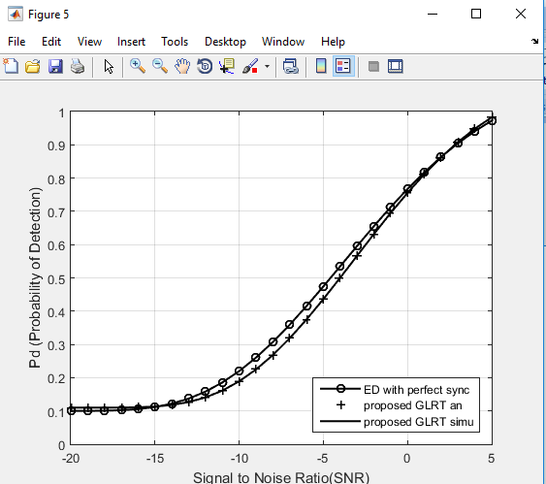
The probability of detection Pd versus SNR with Pfa = 0.1. The arrival time is assumed to be exponentially distributed with mean arrival time t⁻ⁱ = 30. As verified in the figure, the GLRT detector is not sensitive to the distribution of delay (which is typically unknown), and its performance can still approach to that of the benchmark, which is also observed.

Slide 25
SOFTWARE REQUIREMENTS
Matlab7.14
MATLAB is a high-performance language for technical computing. It integrates computation, visualization, and programming in an easy-to-use environment where problems and solutions are expressed in familiar mathematical notation. Typical uses include:
Math and computation
Algorithm development
Modeling, simulation, and prototyping

Slide 26
CONCLUSION
Spectrum sensing in asynchronous transmissions is important in many wireless communication systems, in particular for the studies of CR femtocell networks. Theoretical analysis on the proposed estimator and detector was given in this paper. The performance of the proposed GLRT detector was shown to approach to optimal performance, regardless the distribution of timing misalignment. In this sense, the proposed approach is practical and promising for real-time CR applications in the presence of unknown arrival times of the primary signals. Our future research effort will be dedicated to extending the current study to a more complex primary signal traffic model with random arrival and departure times.

Slide 27
Extension
Using a local optimum detector to detect the random arriving signals with a varying correlation coefficient.

Slide 28
Research paper
A locally optimum detector for detection of random signals under a weakly correlated noise model over fading channels

Slide 29
Literature survey
In modern cognitive radio networks, to avoid interference from secondary users to primary holders with license in spectrum, it is need to have an appropriate spectrum sensing. In methods like spectrum sensing, where samples of noise are correlated, the impairments from independent noise samples do not provide optimum performances. So, in case of random signals over a weakly correlated noise model in fading channels requires a locally optimum detection method has been proposed in this paper

Slide 30
Gaps in literature
The most expensive and limited resource for wireless communications are Radio Frequency (RF) spectrums
So there are two types of users primary uses, secondary users
Spectrum sensing is used for optimum transmission
Among these energy detection is simple technique and optimized with impairment of additive white Gaussian noise (AWGN).The additive noise samples are statistically independent.
But in real time they will be not be independent ,so we use LO detection

Slide 31
A detection mechanism like locally optimum (LO) of random signals over a weakly correlated noise model over fading channels is implemented. In case of correlated noise environments, rather than simple detection techniques we use to implement LO detection techniques
False alarm and detection probabilities are used to define LO detection
From the probabilities we can determine that simulation results obtained are matching well with theoretical results
When compared simple energy detection with locally optimum detection it is clear that later has better performance

Slide 32
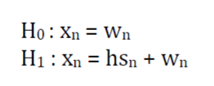
Hypothesis
The two hypotheses assumed are, H0 in which the primary user is said to be absent and H1 once the first user is said to be present, the received signal samples (n = 1, 2, . . .,N) at the secondary user for these two types of hypotheses could also be shapely in equivalent complex baseband
xn is Received signal
h is channel gain
wn is noise samples at secondary users
Sn is primary user signal

Slide 33


In order to derive a test statistic to recognize between two hypothesis H0 and H1, we start with the globally optimal (GO) decision statistic expressed as
Fw is pdf of noise signals

Slide 34

In real time the correlation between noises is unknown
we denote the real correlation coefficient with ρ
the estimated one with ˆρ
By using the hypothesis we calculated probabilty of detection

Slide 35
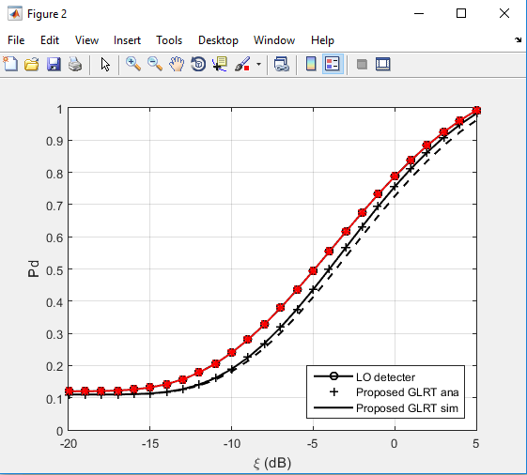
Detection probability vs SNR
At secondary user a fading channel with weakly correlated noise, N=500 samples are taken
Calculating false alarm probability at different SNR values
`

Slide 36
Conclusion
A locally optimum detector for detection of random signals under a weakly correlated noise model over fading channels can be used over normal detector
LO detector is better compared to normal detector in real life situations due to correlated noise
The probabilities of false alarm and detection clearly explains that LO detector has less false alarm probability and high detection probability when compared with energy detector

Slide 37
REFERENCES
[1] D. Qu, Z. Wang, and J. Tao, “Extended active interference cancellation for sidelobe suppression in cognitive radio OFDM systems with cyclic prefix,” IEEE Trans. Vehicular Tech., vol. 59, no. 4, pp. 1689-1695, May 2010.
[2] X. Wang, “Joint sensing-channel selection and power control for cognitive radios,” IEEE Trans. Wireless Commun., vol. 10, no. 3, pp. 958-967, Mar. 2011.
[3] X. Huang, T. Han, and N. Ansari, ?On Green Energy Powered Cognitive Radio Networks,? IEEE Communications Surveys and Tutorials, DOI: 10.1109/COMST.2014.2387697, 2015.
[4] T. Han and N. Ansari, ?Enabling Mobile Traffic Offloading via Energy Spectrum Trading,? IEEE Transactions on Wireless Communications, vol. 13, no.6, pp. 3317-3328, June 2014.

Slide 38
REFERENCES
[5] H. Sun, D. I. Laurenson, and C. X. Wang, “Computationally tractable model of energy detection performance over slow fading channels,” IEEE Commun. Lett., vol. 14, no. 10, pp. 924-926, Oct. 2010.
[6] M. Lopez-Benitz and F. Casadevall, “Improved energy detection spectrum sensing for cognitive radio,” IET Commun., vol. 6, no. 8, pp. 785-796, Jul. 2012.
[7] A. Bagwari and G. S. Tomar, “Adaptive double-threshold based energy detector for spectrum sensing in cognitive radio networks,” International J. Electron. Lett., vol. 1, no. 1, pp. 24-32, Apr. 2013
[8] T. Do and B. L. Mark, “Improving Spectrum Sensing Performance by Exploiting Multiuser Diversity,” Foundation of Cognitive Radio Systems, Prof. Samuel Cheng (Ed.), ISBN: 978-953-51-0268-7, Mar. 2012.

Slide 39
THANK YOU

